Slide 1
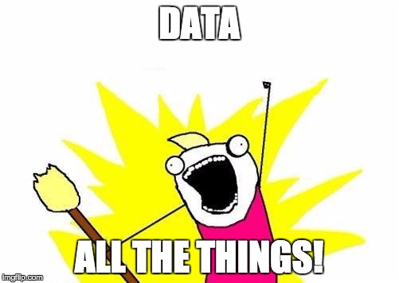
Storing & Securing Data in Azure
#DECODEDConf
David Makogon, Microsoft
@dmakogon

Slide 2
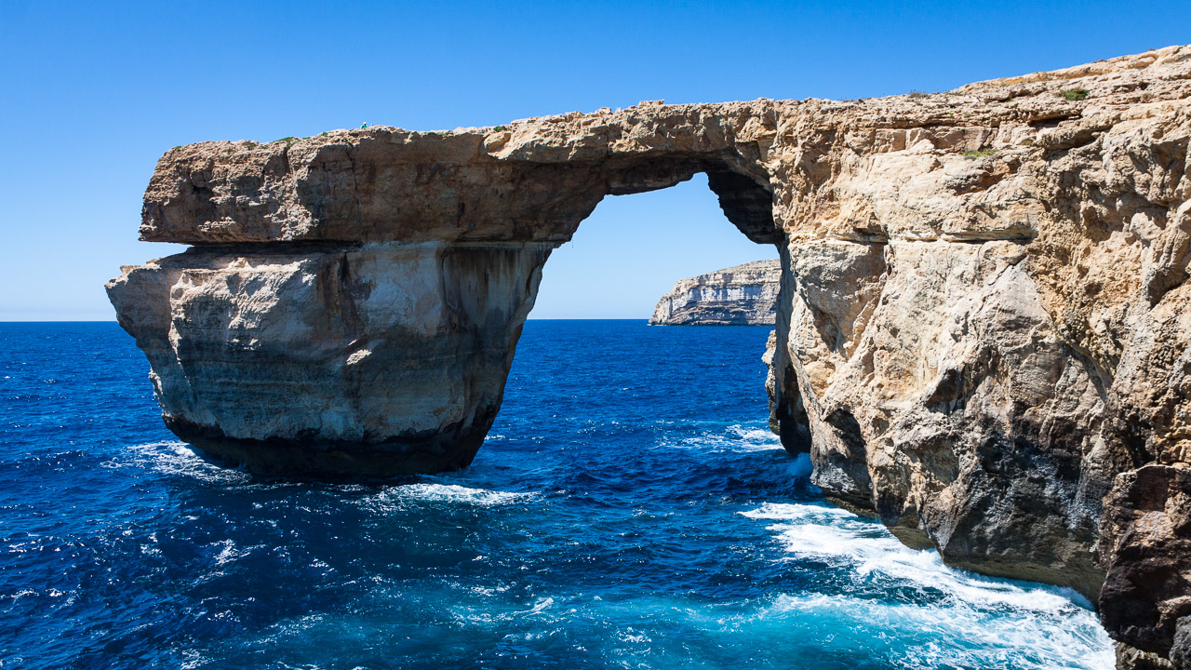

Who am I??? (hint: → David Makogon)
Azure architect
Camera carrier
Pun penner
NoSQL non-novice
Community congrat collector
- (World's first former) Azure MVP
- (Former) MongoDB Master
- Neo4j Ambassador
The stenographer was convicted of a crime, but received a shortened sentence...

Slide 3
For your architect-hat-covered brain today:
Setting the stage
Database options in Azure
Un-hackable-ing those databases
What this isn't about (but still important)
Your favorite DB in a VM
Your own password hygiene
Your personal data being hacked somewhere else

Slide 4
The Data Landscape

Slide 5
So much data!
90% of the world’s data has been created in the last two years….
George Lee. Chief Information Officer, Investment Banking Division, Goldman Sachs

Slide 6
Data growth
130 billion gigabytes in 2010
4.4 zettabytes* in 2013
IDC projections:
44 zettabytes by 2020
180 zettabytes by 2025
* 1 Zettabyte = 1 trillion gigabytes

Slide 7
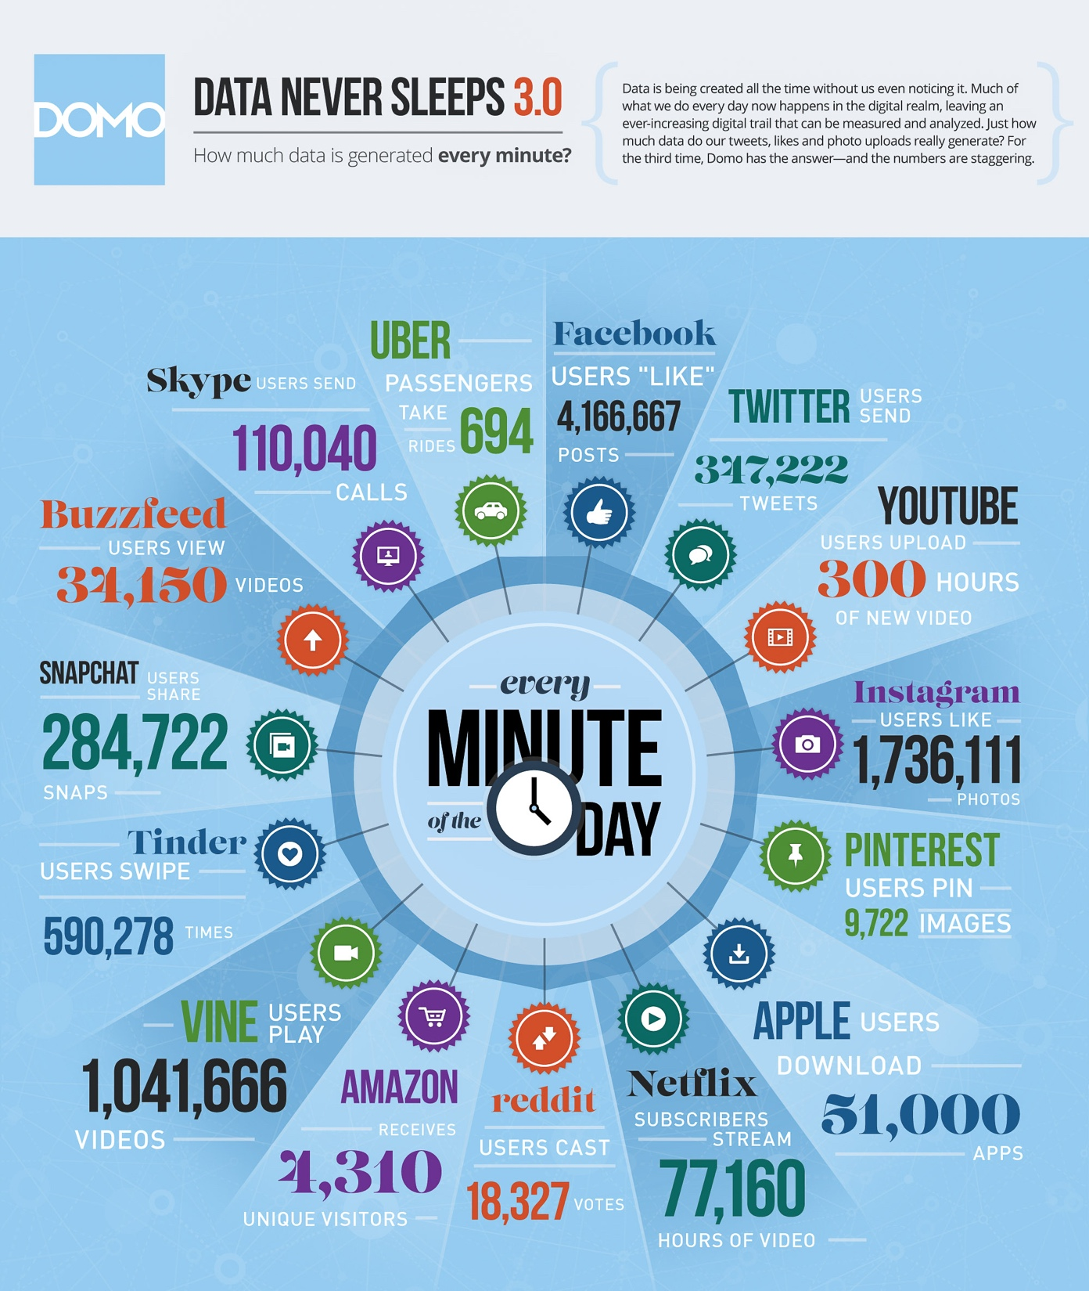
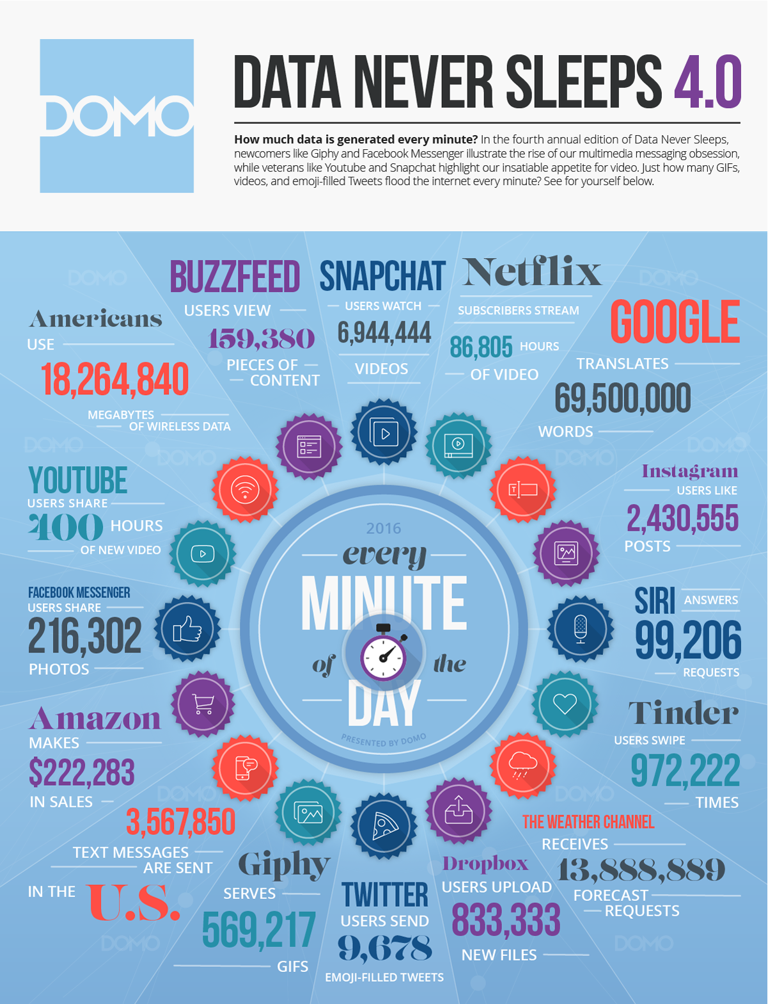
 | 2012 | 2015
YouTube | 48 hours | 300 hours
Twitter | 100,000 tweets | 347,000 tweets
Instagram | 3,600 shares | 1.7 million likes
Facebook | 684,000 shares | 4.1 million likes
Vine | Non-existent | 1 million views
Snapchat | Non-existent | 285,000 snaps
Tinder | Non-existent | 590,000 swipes
Data generated per minute:

Slide 8
 | 2015 | 2016
YouTube | 300 hours | 400 hours
Instagram | 1.7 million likes | 2.4 million likes
Tinder | 590,000 swipes | 972,000 swipes

Slide 9

The shape of data
Golden Hammer anti-pattern:
When all you have
is a hammer…
Jennifer Boyer – “Nails" - https://flic.kr/p/7J9mJQ

Slide 10
Avoiding the Golden Hammer
Multiple database categories and data shapes
Relational
Document
Key/Value
Graph
Column

Slide 11
Options in Azure?
PaaS
Relational
Document
Key/value
IaaS (including containers)
Anything, including graph and column
3rd-party?
Relational, Document, Graph (maybe more)

Slide 12
Thinking cap:
PaaS
Relational, Document, Key/value
IaaS
Anything, including graph and column
3rd-party?
Relational, Document, Graph (maybe more)
Oh! And Web Apps

Slide 13
Thinking cap: PaaS vs IaaS
PaaS | IaaS
Someone else makes it work | You own it! You maintain it!
Service SLA | Virtual Machine SLA
Data durability (usually with backups) | Data durability is up to you
Security built-in | DEAL WITH SECURITY!!!
Scaling limited by service offering | Scaling limited by # of VMs and disks
Service-based pricing | VM- and storage-based pricing
No license worries | Licenses are important
New features "just appear" | You must keep up with new versions
Not necessarily a complete list...

Slide 14
Let's also think about... security!
How will you, as DB owner, avoid hackage?
PaaS handles lots of things, but still needs attention!
IP whitelisting, password/key protection
IaaS needs much more help!
Database security
Virtual networks
IP whitelisting
Jumpbox

Slide 15
Portal time!

Slide 16
Key/value databases

Slide 17
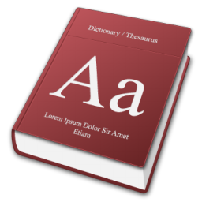
What’s a key/value store?
Effectively, this ->
You search for a Key to find an opaque value

Slide 18
Why use a Key/Value store?
Very rapid, discreet look-ups
When you always know the Key
When you only ever query by Key

Slide 19
Less optimal?
Searching on properties within the Value
Complex queries

Slide 20
Options in Azure?
PaaS
Azure Table Storage
Redis Cache service
IaaS
Redis
Riak
Memcached
And so many more ….

Slide 21
Demo – key/value database

Slide 22
Document databases

Slide 23
What’s a document database?
NOT for this kind of document !

Slide 24
What’s a document database?
{
“id": “13244_user",
"firstName": "John",
"lastName": "Smith",
"age": 25,
"address":
{
"streetAddress": "21 2nd Str",
"city": "New York",
"state": "NY",
"postalCode": "10021"
},
“mobileNumber": "212 555-1234"
}
For this kind of document -

Slide 25
Developer Appeal
Promotes code first development
Resilient to iterative schema changes
Richer query and indexing (compared to KV stores)
Low impedance as object / JSON store; no ORM required
I
developers

Slide 26
Use Cases and Applicability
Mobile and Web
User data store
IoT scenarios
Event workflow and logging
Data ingestion and presentation
Product catalogs

Slide 27
Less optimal use
Complex relational data
Complex map/reduce aggregations
Distributed transactions
OLAP

Slide 28
Options in Azure?
PaaS
Azure DocumentDB
mLab, MongoDB, Compose
RavenHQ
Iaas
MongoDB
CouchDB
Couchbase
ArangoDB
And countless more …

Slide 29
Example query: DocumentDB
SELECT * FROM f WHERE f.id = "AndersonFamily"
var query = from f in client.CreateDocumentQuery<Family>(collectionLink)
where f.Id == "AndersonFamily"
select f;

Slide 30
Demo – document datatabase

Slide 31
Graph databases

Slide 32
What’s a graph database?
Nodes and relationships
And properties
And all the query stuff

Slide 33



What’s a graph database?
Maybe I should see that movie…
I reviewed that movie!
Reviewed
Friends with

Slide 34
Why a graph database?
Ideal for complex connections
Easy navigation between things (nodes)
No need for complex joins
Easy to add to, and evolve, existing model

Slide 35
Why a graph database?
Less-than-optimal:
Complex relational data
OLAP

Slide 36
Options in Azure?
PaaS
Graph Story
GrapheneDB
IaaS
Neo4j
Dex
OrientDB
InfiniteGraph
AllegroGraph
And many more!

Slide 37
Example query: Neo4j
(ryan:Person)-[:FRIENDS_WITH]->(david:Person)
-[:REVIEWED]->(movie:Movie {Title:’Fletch’})

Slide 38
Demo – graph database

Slide 39
Column databases

Slide 40
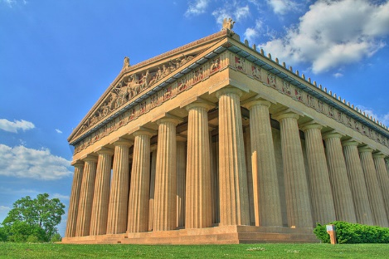
Column stores
Not these columns:
Will Powell – “Nashville Parthenon – HDR” - https://flic.kr/p/2k8TxH

Slide 41
What’s a column store?
Data is keyed by row (e.g. Twitter ID)
Individual content stored as columns
Groups of columns comprise a column family

Slide 42
Example: Weather data
Data is keyed by row (e.g. weather station ID)
Columns may have standard or custom names
For weather: Each col name = date
stationID | Timestamp temp | Timestamp temp | Timestamp temp | …
stationID | Timestamp temp | Timestamp temp | Timestamp temp | …

Slide 43
Why a column family? Why not?
Optimal:
Very large quantities of data
Queries well-known up-front
Scale and durability
Non-optimal:
Highly-relational data
Querying on many different properties

Slide 44
Options in Azure?
IaaS
Cassandra
HBase

Slide 45
Using Cassandra + CQL
CREATE TABLE temperature (
stationID text,
readingtime timestamp,
temp text,
PRIMARY KEY (stationID,readingtime)
);
INSERT INTO temperature(stationID,readingtime,temp)
VALUES (‘1’,’2015-02-23 09:00:00′,’45F’);

Slide 46
Finding temperatures
SELECT readingtime,temp
FROM temperature
WHERE stationID=’1’;

Slide 47
Questions?
Twitter: @dmakogon
Blog: dmak.io
Facebook: facebook.com/dmak.online
StackOverflow: david-makogon
Azure stuff at Azure.com
Talk stuff at github.com/dmakogon/globalazure2017

Slide 48
Notes:
Dark gray background.

